Slide 1
Composites
Aerospace Manufacturing Core Study Guide
“AMCSG-205”
Tools & Processes

Slide 2
Composites

Slide 3
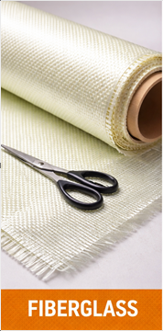
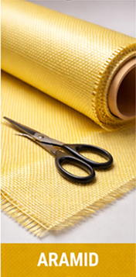
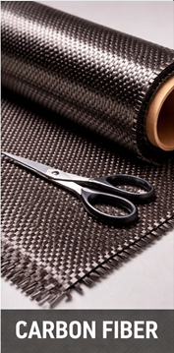
Composite Types
Text from ChatGPT
Composites beat metal because of
Higher Strength-to-Weight ratio
Better Corrosion and Fatigue Resistance
More Complex, Aerodynamic Shapes
Fewer Parts
Three Types:
Fiberglass
Aramid (Kevlar)
Carbon Fiber
Made of Fiber + Resin + Core
ChatGPT / Matt Pierce, 2026
Fiberglass
ChatGPT / Matt Pierce, 2026
Aramid
ChatGPT / Matt Pierce, 2026
Carbon Fiber
Notes:
ChatGPT: “make one picture showing three types of aircraft manufacturing fiber side by side: fiberglass, aramid, and carbon fiber.”

Slide 4
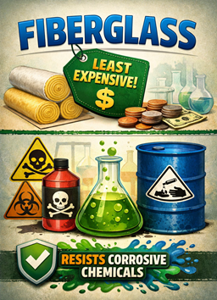
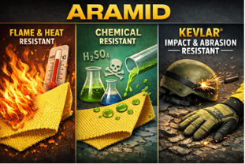
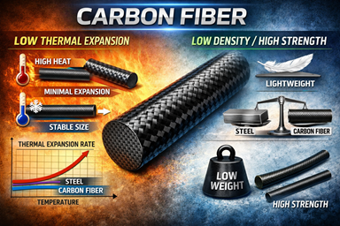
Composite Type Strengths
Text from ChatGPT
Fiberglass
Resistant to Harshest Chemicals
Least Expensive
Aramid
Good Impact & Abrasion Resistance
Flame / Thermal Degradation Resistant
Chemical Resistant
Carbon Fiber (Graphite)
Lowest Density / Highest Strength
Low Thermal Expansion
ChatGPT / Matt Pierce, 2026
ChatGPT / Matt Pierce, 2026
ChatGPT / Matt Pierce, 2026
Notes:
Fiberglass – ChatGPT: make an image indicating fiberglass is the least expensive, and is resistant to chemicals + Edit output manually
Aramid – ChatGPT: make an image indicating Aramid is flame/thermal resistant, chemical resistant, and as kevlar is impact and abrasion resistant
Carbon Fiber – ChatGPT: make an image indicating carbon fiber has low thermal expansion, and low density/high strength

Slide 5
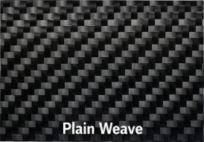
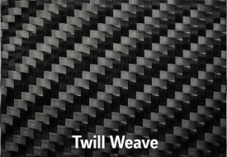
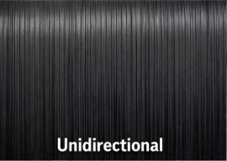
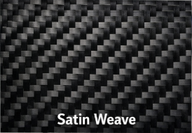
Carbon Fiber Weave Patterns
Text from Google AI
Plain Weave
Simple over/under checkerboard
Flat, Structural, or Interior Cabin
Twill Weave
Highly Versatile, Complex Contours
Satin Weave
Highly Pliable, Complex Contours
Unidirectional Weave
Tape, not a weave / one direction
Wings, spar caps
Plain Weave
Twill Weave
Unidirectional
Satin Weave
ChatGPT / Matt Pierce, 2026
Notes:
ChatGPT: “make a picture showing the various Carbon fiber weaves in aircraft manufacturing. Show plain, twill, satin, and unidirectional weaves.”
Google AI: “what are the different weave patterns for carbon fiber for aircraft manufacturing”

Slide 6
Resins
Text from Google AI
Final Composite Material = Fiber + Resin
Resin hardens the fiber into final shape – “without Resin…it’s just a pile of floppy strings ☺”
Four Types of Resin:
Thermoset resin systems – plastic, needs to be heated to cure, good for aircraft
Phenolic resin systems – fire retardant, heat resistant, good for aircraft
Pre-Impregnated materials – like a roll of tape with resin already embedded
Epoxy resin systems – widely used for adhesion, strength, resist chemicals
Notes:
Google AI: “what are the different weave patterns for carbon fiber for aircraft manufacturing” … Prior slide research…talked about resin, so I added a slide here too

Slide 7
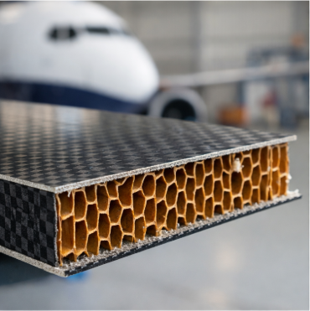
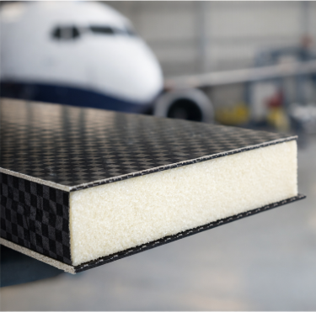
Core Types
Text from ChatGPT
A “Core” is Material Sandwiched Between 2 Composite Sheets
Honeycomb Core – Aluminum, Nomex, Carbon Fiber, Phenolic
Foam Core – Styrofoam, Urethane, PVC
Honeycomb
Foam
ChatGPT / Matt Pierce, 2026
ChatGPT / Matt Pierce, 2026
Notes:
ChatGPT: “make a side-by-side picture showing two different core materials (honeycomb vs. foam) for aircraft composite materials”

Slide 8
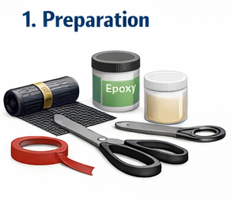
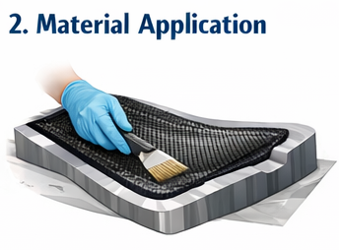
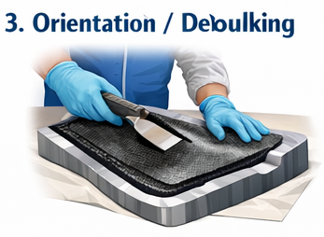
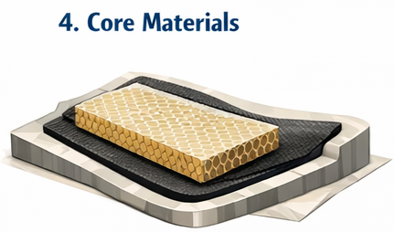
Layup Process
Text from GoogleAI
The “Layup Process” is simply stacking layers of carbon fiber onto a mold to build a part’s shape.
Preparation: Mold cleaned then coated with release agent
Material Application: Layers of composite material added to mold
Orientation/Debulking: Layer orientation varies for strength. Debulking is compacting to remove air.
Core Materials: Add honeycomb or foam core between layers if req’d
ChatGPT / Matt Pierce, 2026
ChatGPT / Matt Pierce, 2026
ChatGPT / Matt Pierce, 2026
ChatGPT / Matt Pierce, 2026
Notes:
Google AI: “simple definitions for "layup process" and "bagging process" in aircraft manufacturing of composite parts”
Google AI: “what is the layup and bagging process in aircraft manufacturing of composite parts”
ChatGPT: “Make a step by step process diagram showing how the layup and bagging process is done in aircraft manufacturing of composite parts. Show "Layup Process" as four steps: Preparation, Material Application, Orientation/Debulking, and core materials. Show "Bagging Process" as four steps: Peel Ply/Release Film, Breather Material, Vacuum Bag / Seal, and Vacuum Application/Cure.”

Slide 9
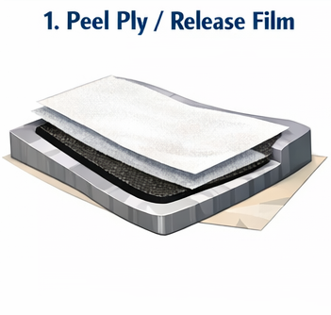
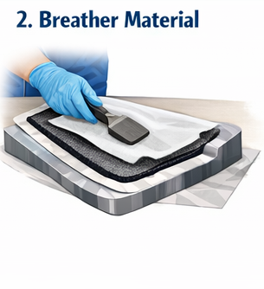
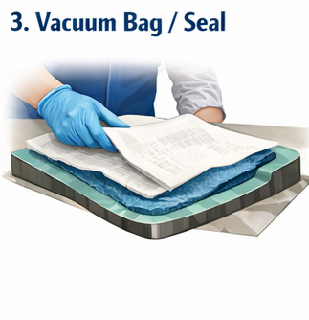
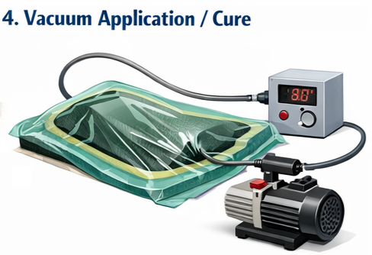
Bagging Process
Text from GoogleAI
The “Bagging Process” is a technique to seal the layered, uncured composite part inside a plastic airtight bag, then removes air for uniform pressure during curing.
Peel Ply & Release Film: Placed over uncured part to prevent bag from sticking
Breather Material: Porous breather cloth added facilitate uniform vacuum
Vacuum Bag & Seal: Flexible, airtight, nylon bag cover entire assembly; sealed to mold with sealant tape
Vacuum Application & Cure: Pump out air, atmospheric pressure consolidates layers + resin. Cured in autoclave or oven under controlled heat.
ChatGPT / Matt Pierce, 2026
ChatGPT / Matt Pierce, 2026
ChatGPT / Matt Pierce, 2026
ChatGPT / Matt Pierce, 2026
Notes:
Google AI: “simple definitions for "layup process" and "bagging process" in aircraft manufacturing of composite parts”
Google AI: “what is the layup and bagging process in aircraft manufacturing of composite parts”
ChatGPT: “Make a step by step process diagram showing how the layup and bagging process is done in aircraft manufacturing of composite parts. Show "Layup Process" as four steps: Preparation, Material Application, Orientation/Debulking, and core materials. Show "Bagging Process" as four steps: Peel Ply/Release Film, Breather Material, Vacuum Bag / Seal, and Vacuum Application/Cure.”

Slide 10
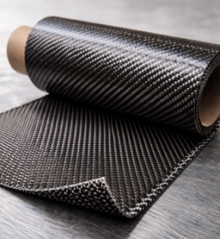
Fiber “Warp Threads” and “Fill Threads”
Text from GoogleAI
Warp Fibers – “Yellow Arrow”
Runs Length of Roll
= “Warp Direction”
Strongest in this direction
Warp Face – “Green Arrow”
“Up” = Top Face as is Unrolled
Fill Threads – “White Arrow”
Perpendicular to Warp fibers
Parallel/Lateral to Roll
ChatGPT / Matt Pierce, 2026
Notes:
Google AI: “composite material fiber, ply orientation, warp direction, warp face, warp threads, fill threads, warp clock”
Chat GPT: “make a single diagram showing a roll of composite fiber material coming off the roll; be zoomed in on the material as it comes off the roll so can see the warp face and warp direction” + Remove the labels and arrows for "warp face" and "warp direction“ + make the unrolled surface curled up a bit (not flat), and cut it about 12" from the end

Slide 11
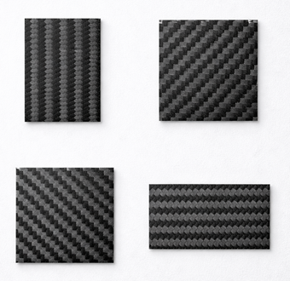
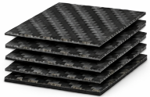
“Ply Direction” Impacts Strength
Warp Fiber Direction
Balanced Plies
Symmetrical Plies
0° / 90°
0° / +45° / +45° / 0°
0°
45°
Unbalanced Plies
Quasi-Isotropic Plies
0° / +45° / +45° / 0°
0° / +45° / -45° / 90°
90°
-45°
ChatGPT / Matt Pierce, 2026
ChatGPT / Matt Pierce, 2026
Notes:
Chat GPT: “make a photo showing 4 small 2" x 2" squares of carbon fiber. show one square at warp ply direction 0°, one at -45°, one at 45°, and one at 0°.” + “make the upper left square go up-and-down vertically. make the lower right square label = 90° and direction be left-to-right horizontally.” + “Remove text labels. Leave pictures as they are.”
Chat GPT: “make a diagram showing the following: 1. a small square of composite fabric with its ply orientation = warp fiber direction. 2. several small squares of composite fabric with a "Balanced" ply orientation 3. several small squares of composite fabric with an "Unbalanced" ply orientation 4. several small squares of composite fabric with a "Symmetrical" ply orientation 5. several small squares of composite fabric with a "Quasi-Isotropic" ply orientation”

Slide 12
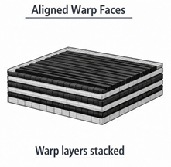
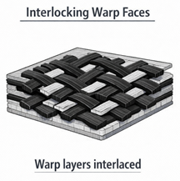
“Ply Orientation” Impacts Strength
Stacking
Nesting
Matt Pierce, 2026
Matt Pierce, 2026
ChatGPT / Matt Pierce, 2026
ChatGPT / Matt Pierce, 2026
Notes:
Chat GPT: make a side-by-side diagram showing the two types of orienting warp faces together of composite fabric sheets: "nesting" vs "stacking“

Slide 13
Q&A

Slide 14
Practice Q&A’s (Q1-Q8)
Q5: Composites beat metal because there are fewer parts to fasten together?
A: True
Q6: Composites beat metal because they are cheaper to make?
A: False
Q7: What is the oldest composite that has been in wide use?
A: Fiberglass
Q8: What is the strongest composite for impact (like stopping a bullet)?
A: Aramid fiber (Kevlar)
Q1: Composites beat metal because they have higher strength to weight?
A: True
Q2: Composites beat metal because they do not corrode?
A: True
Q3: Composites beat metal because they are more fatigue resistant (bend until failure)?
A: True
Q4: Composites beat metal because they can be molded int more complex aerodynamic shapes?
A: True

Slide 15
Practice Q&A’s (Q9-Q16)
Q13: Name of string patterns in the fiber plies (e.g.: plain, twill, satin, or unidirectional)?
A: Weave
Q14: Component of a composite that hardens the soft fiber plies into final shapes?
A: Resin
Q15: Name four types of resin?
A: 1. Thermoset, 2. Phenolic, 3. Pre-Impregnated, and 4. Epoxy
Q16: Name two common core types sandwiched between two outer layers of composite faces
A: 1. Honeycomb, or 2. Foam
Q9: What is the strongest composite for aerospace manufacturing?
A: Carbon fiber
Q10: What composite is the most commonly used today?
A: Fiberglass (like your bathtub wall)
Q11: What composite is best for flame and heat resistance?
A: Aramid fiber
Q12: What fiber has low thermal expansion?
A: Carbon fiber (not stretch like Aluminum on hot days)

Slide 16
Practice Q&A’s (Q17-Q23)
Q20: Name of threads in a ply that run longitudinally (runs length of the roll) and are strongest?
A: Warp threads
Q21: Name of threads in a ply that run perpendicular to warp fibers, laterally across the roll?
A: Fill threads
Q22: Name of the face that curls up when you unroll composite sheet?
A: Warp face
Q23:Name of "schedule" indicating how to layer the warp directions of ply after ply when building a parts?
A: Warp clock
Q17: Part of the composite process where stacking layers of carbon fiber over a molded?
A: Layup Process
Q18: Part of the composite process to seal mold and material placed during Layup Process?
A: Bagging Process
Q19: Is there a bag used in the Bagging Process?
A: No! It is a clear plastic sheet taped down to make an airtight seal over the mold and material that forms a "bag"

Slide 17
Practice Q&A’s (Q24-Q30)
Q28: Name of material used to allow air and fuems to outflow during vacuum and curing processes?
A: Breather material
Q29: Name of cloth fabric used to absorbe excess resin during vacuum and curing processes?
A: Bleeder blanket
Q30: What is the purpose of quasi-isotropic ply orientations?
A: Strength in multiple directions (flexing, twisting)
Q24: Name of ply orientations where warp faces are aligned?
A: Stacking
Q25: Name of ply orietnations where warp faces interlock together?
A: Nesting
Q26: Using honeycomb or foam cores serves what purpose?
A: Increase strength
Q27: What is the most widely used resin?
A: Epoxy

Slide 18
Thank You
Matt Pierce - mpierce710006@gmail.com - linkedin.com/in/mpiercead576/
https://github.com/DataResearchLabs/study_guide_intro_aerospace_mfg

